Slide 1
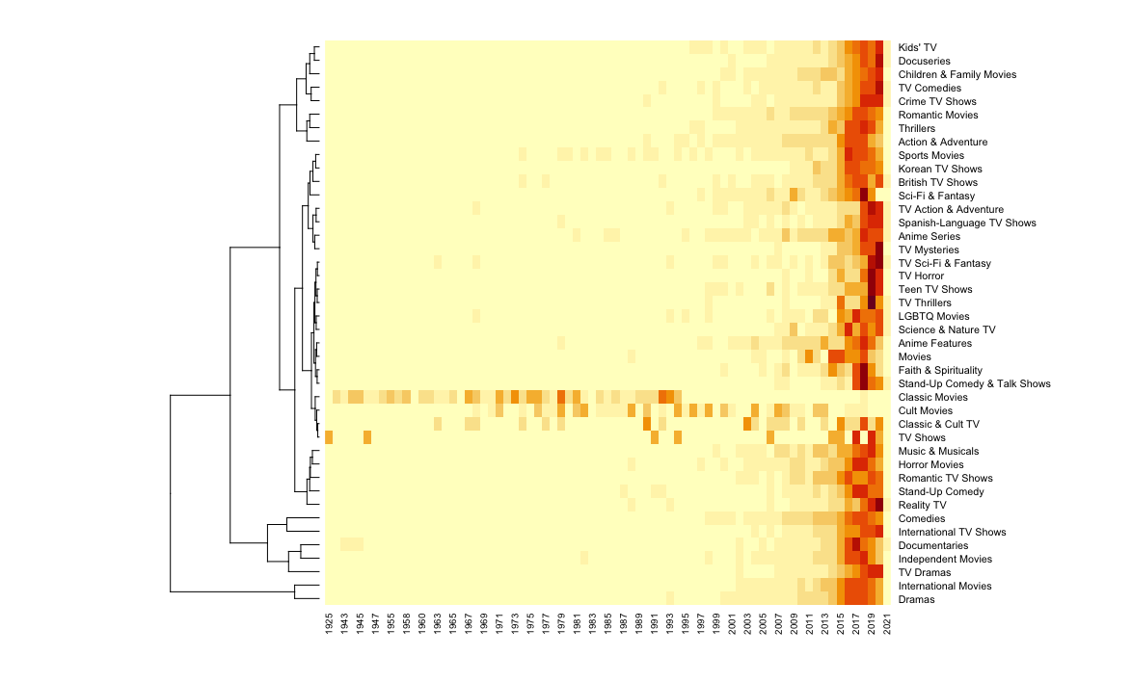
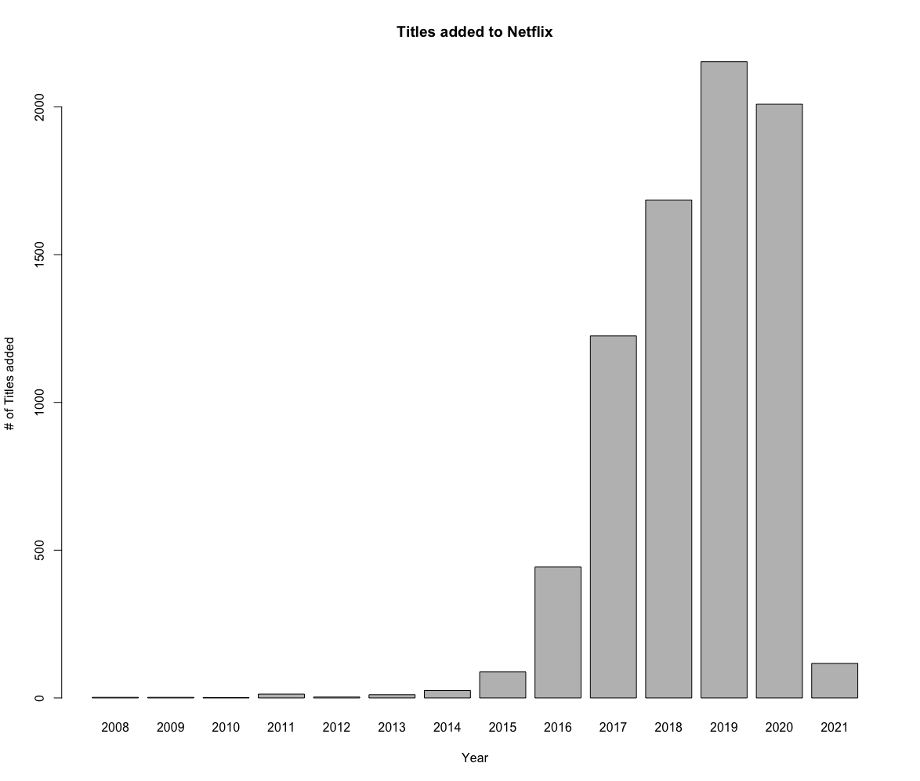
Title
Introduction text
Relesase Date
Heatmap
Heatmap
Pie Chart + Conclusion

